Slide 1
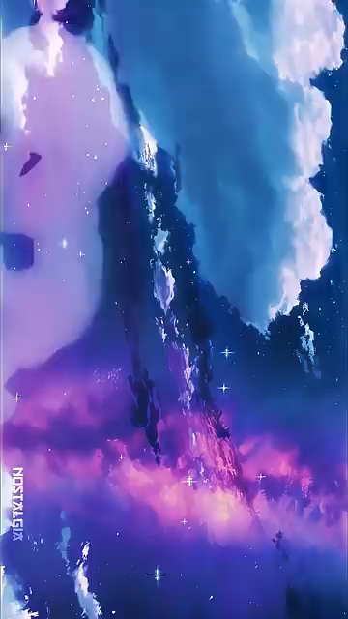

Slide 2
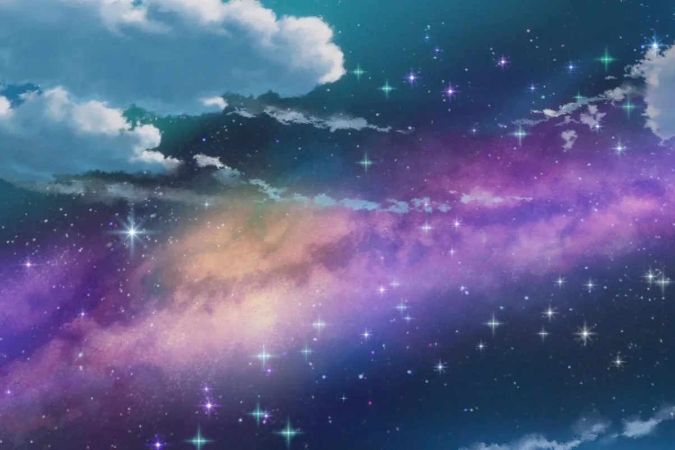
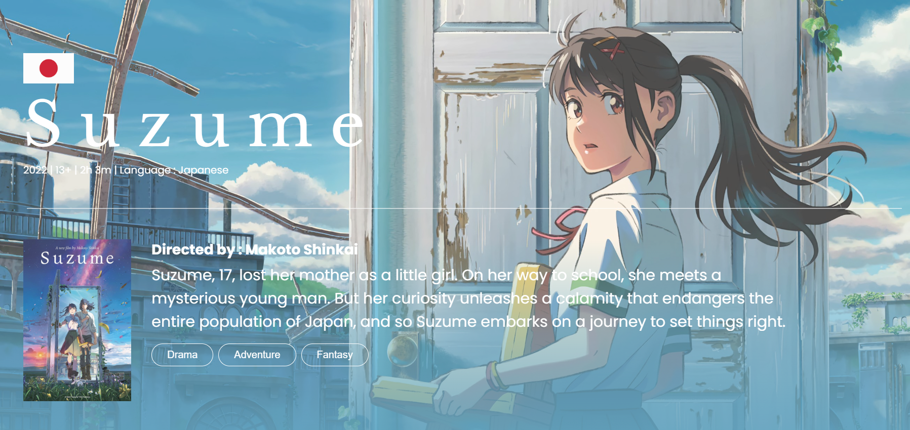
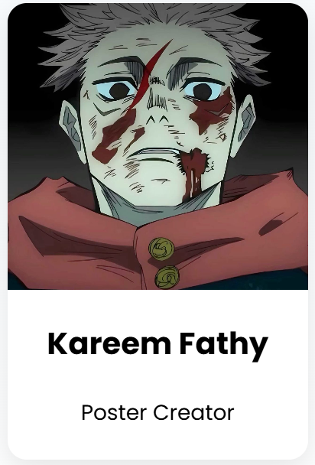
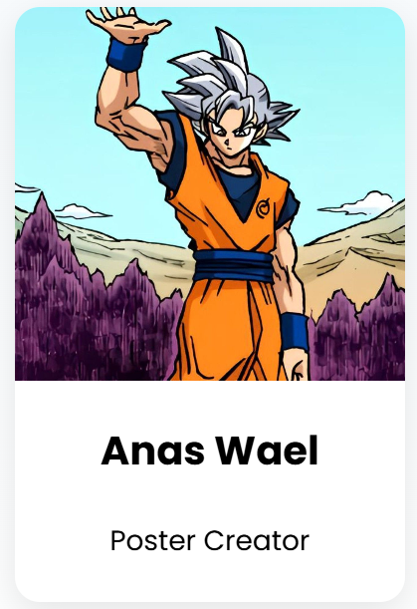
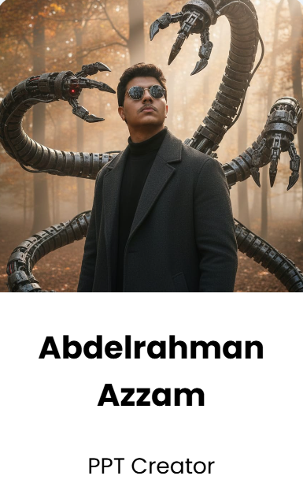
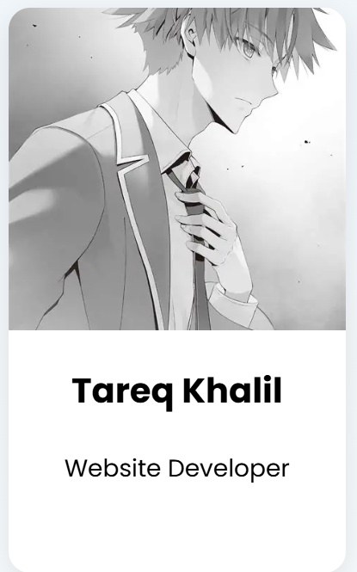
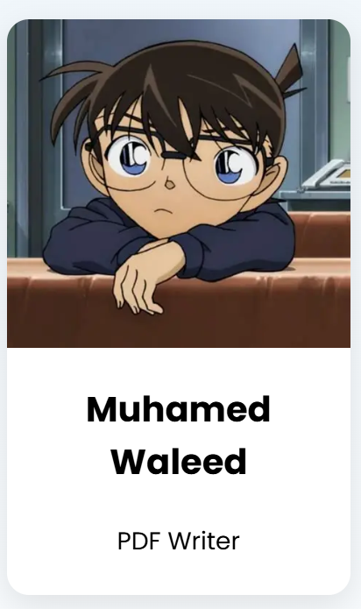

Our Team

Slide 3
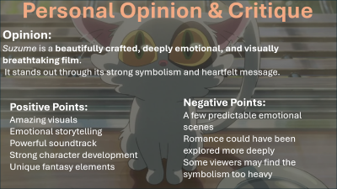
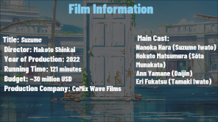
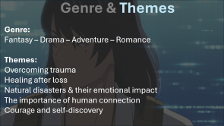
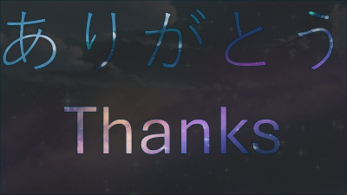
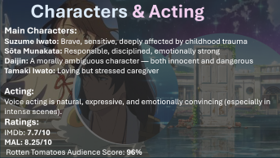
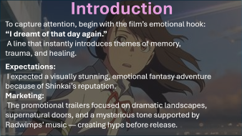
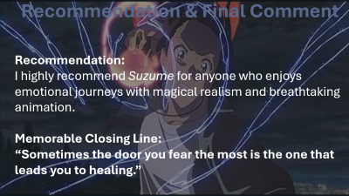
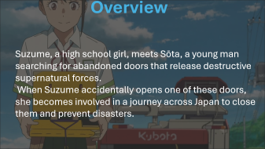

Slide 4
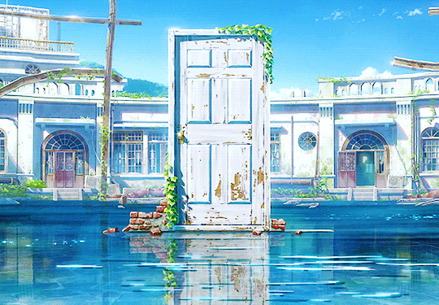
Film Information
Title: Suzume Director: Makoto Shinkai Year of Production: 2022 Running Time: 121 minutes Budget: ~30 million USD Production Company: CoMix Wave Films
Main Cast:
Nanoka Hara (Suzume Iwato)
Hokuto Matsumura (Sōta Munakata)
Ann Yamane (Daijin)
Eri Fukatsu (Tamaki Iwato)

Slide 5
Film Information
Setting Location: Takes place across multiple Japanese cities — Kyushu, Ehime, Kobe, Tokyo, and Tōhoku.
Time Period: Modern Japan (2010s–2020s). Includes flashbacks to the 2011 Tōhoku earthquake.
Awards: Japan Academy Film Prize (Best Music), Mainichi Film Award, international nominations.

Slide 6
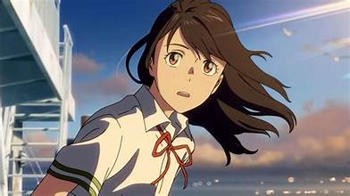

Introduction
To capture attention, begin with the film’s emotional hook:
“I dreamt of that day again.” A line that instantly introduces themes of memory, trauma, and healing.
Expectations: I expected a visually stunning, emotional fantasy adventure because of Shinkai’s reputation.
Marketing: The promotional trailers focused on dramatic landscapes, supernatural doors, and a mysterious tone supported by Radwimps’ music — creating hype before release.

Slide 7
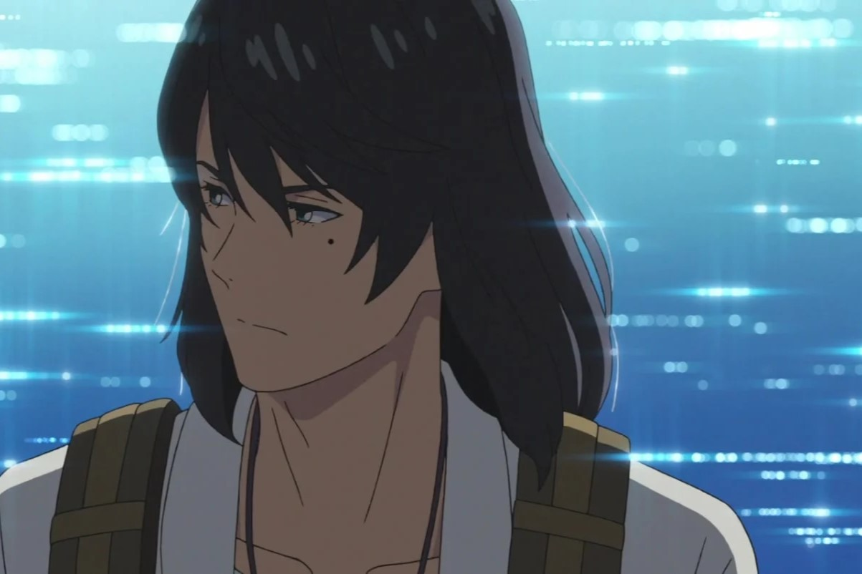
Genre & Themes
Genre:
Fantasy – Drama – Adventure – Romance
Themes:
Overcoming trauma
Healing after loss
Natural disasters & their emotional impact
The importance of human connection
Courage and self-discovery

Slide 8
Genre & Themes
General Message:
A message of resilience — even after disaster, people can rebuild emotionally and physically.
Moral:
We cannot change the past, but we can learn to live with it and keep moving forward.

Slide 9
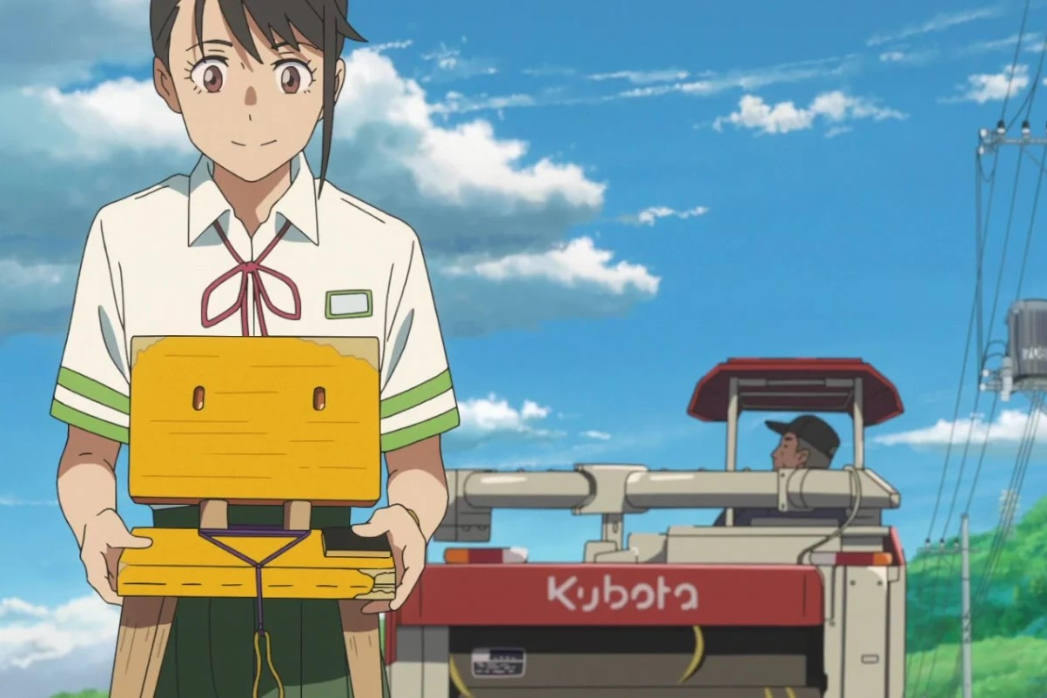
Overview
Suzume, a high school girl, meets Sōta, a young man searching for abandoned doors that release destructive supernatural forces. When Suzume accidentally opens one of these doors, she becomes involved in a journey across Japan to close them and prevent disasters.

Slide 10
Overview
During this journey:
She confronts hidden trauma
She grows emotionally
She discovers her connection to a past tragedy
She bonds with Sōta, who becomes both her partner and guide
Plot Structure:
Adventure-based
Emotional development
Contains twists
Some predictable moments, but still engaging Mix of realism, magic, and symbolism

Slide 11
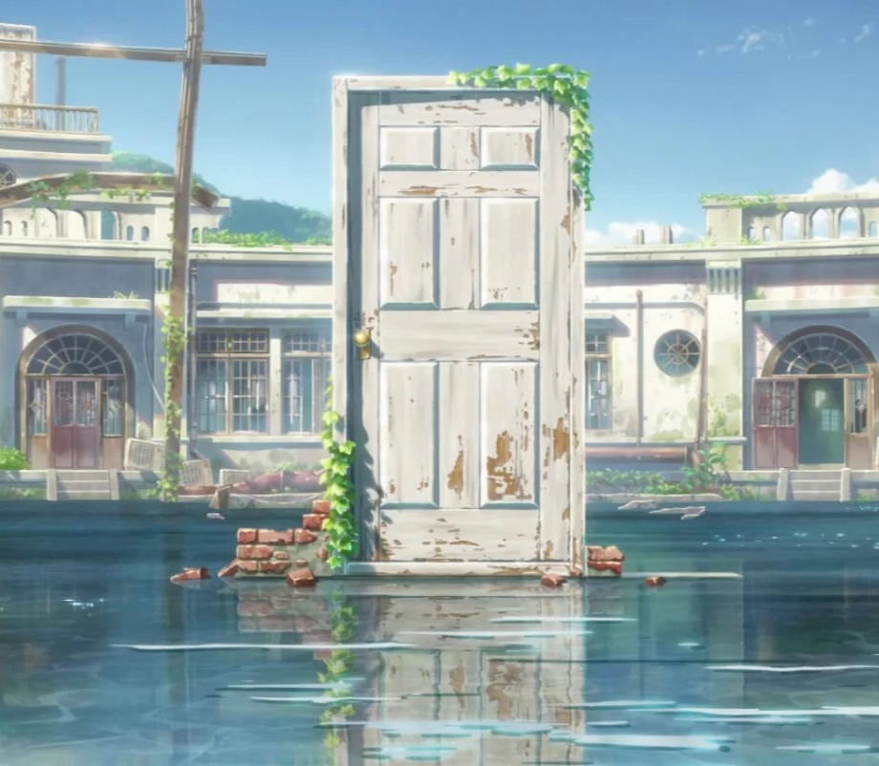
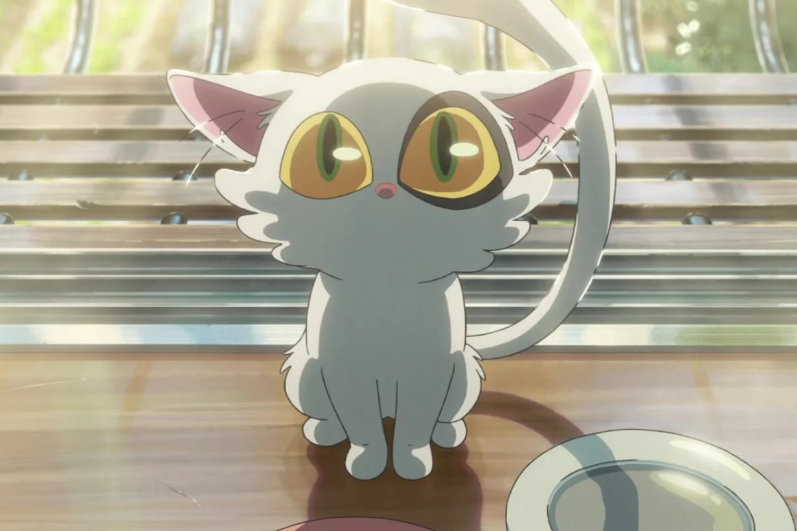
Characters & Acting
Main Characters:
Suzume Iwato: Brave, sensitive, deeply affected by childhood trauma
Sōta Munakata: Responsible, disciplined, emotionally strong
Daijin: A morally ambiguous character — both innocent and dangerous
Tamaki Iwato: Loving but stressed caregiver
Acting:
Voice acting is natural, expressive, and emotionally convincing (especially in intense scenes).
Ratings:
IMDb: 7.7/10
MAL: 8.25/10 Rotten Tomatoes Audience Score: 96%

Slide 12
Personal Opinion & Critique
Opinion:
Suzume is a beautifully crafted, deeply emotional, and visually breathtaking film. It stands out through its strong symbolism and heartfelt message.
Negative Points:
A few predictable emotional scenes
Romance could have been explored more deeply
Some viewers may find the symbolism too heavy
Positive Points:
Amazing visuals
Emotional storytelling
Powerful soundtrack
Strong character development
Unique fantasy elements

Slide 13
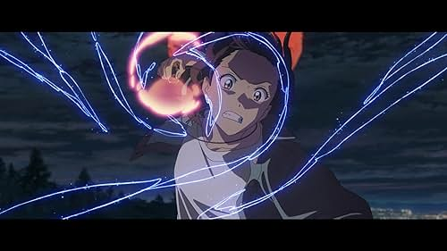
Recommendation & Final Comment
Recommendation:
I highly recommend Suzume for anyone who enjoys emotional journeys with magical realism and breathtaking animation.
Memorable Closing Line:
“Sometimes the door you fear the most is the one that leads you to healing.”

